Slide 1
Define bias and varience
Bias: Bias is a prediction error that is introduced in the model due to oversimplifying the machine learning algorithms. Or it is the difference between the predicted values and the actual values.
Variance: If the machine learning model performs well with the training dataset, but does not perform well with the test dataset, then variance occurs.

Slide 2
What is generalized model
generalization defines the ability of an ML model to provide a suitable output by adapting the given set of unknown input. It means after providing training on the dataset, it can produce reliable and accurate output. Hence, the underfitting and overfitting are the two terms that need to be checked for the performance of the model and whether the model is generalizing well or not.

Slide 3
What is overfitting
Overfitting occurs when our machine learning model tries to cover all the data points or more than the required data points present in the given dataset. Because of this, the model starts caching noise and inaccurate values present in the dataset, and all these factors reduce the efficiency and accuracy of the model. The overfitted model has low bias and high variance.
The chances of occurrence of overfitting increase as much we provide training to our model. It means the more we train our model, the more chances of occurring the overfitted model.
Overfitting is the main problem that occurs in supervised learning.

Slide 4
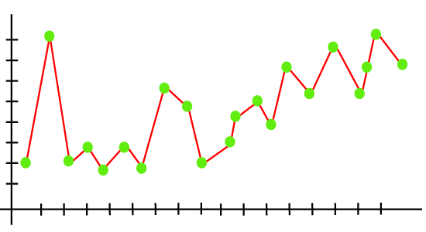
Example: The concept of the overfitting can be understood by the below graph of the linear regression output:
As we can see from the above graph, the model tries to cover all the data points present in the scatter plot. It may look efficient, but in reality, it is not so. Because the goal of the regression model to find the best fit line, but here we have not got any best fit, so, it will generate the prediction errors.

Slide 5
What is underfitting
Underfitting occurs when our machine learning model is not able to capture the underlying trend of the data. To avoid the overfitting in the model, the fed of training data can be stopped at an early stage, due to which the model may not learn enough from the training data. As a result, it may fail to find the best fit of the dominant trend in the data.
In the case of underfitting, the model is not able to learn enough from the training data, and hence it reduces the accuracy and produces unreliable predictions.
An underfitted model has high bias and low variance.

Slide 6
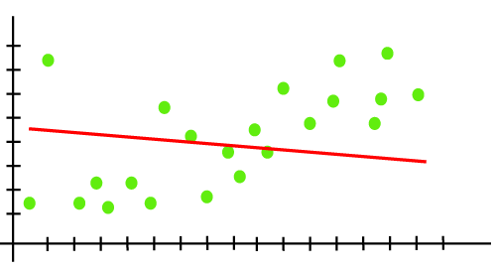
Example: We can understand the underfitting using below output of the linear regression model:
As we can see from the above diagram, the model is unable to capture the data points present in the plot.

Slide 7
What is bias variance tradeoff
Bias Variance Tradeoff
If the algorithm is too simple (hypothesis with linear eq.) then it may be on high bias and low variance condition and thus is error-prone. If algorithms fit too complex ( hypothesis with high degree eq.) then it may be on high variance and low bias. In the latter condition, the new entries will not perform well. Well, there is something between both of these conditions, known as Trade-off or Bias Variance Trade-off.
This tradeoff in complexity is why there is a tradeoff between bias and variance. An algorithm can’t be more complex and less complex at the same time. For the graph, the perfect tradeoff will be like.

Slide 8
